Slide 1
CP 23 - TechLab Upgrade
Hand of the Fek

Slide 2
Overall Context
Notes:
How we prioritised user stories - high priority level for the ones that the client’s requested or showed strong interest. Lower for the ones that we brought it up ourselves to implement

Slide 3
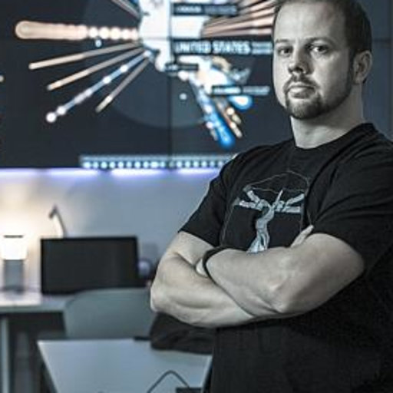

Clients
Jim Cook
Viji Venkataramani

Slide 4
Team Members
Vicky Lin
Cameron Williamson
Clinton Mo
JooHwan Kwon
Adam Ghanem

Slide 5
TechLab Description
URL: trends.techlab.works
Web platform for sharing tech trends and projects by TechLab
Targeted at students, staff, educators, researchers and external partners
TechLab aims to provide a source of information for research projects.

Slide 6
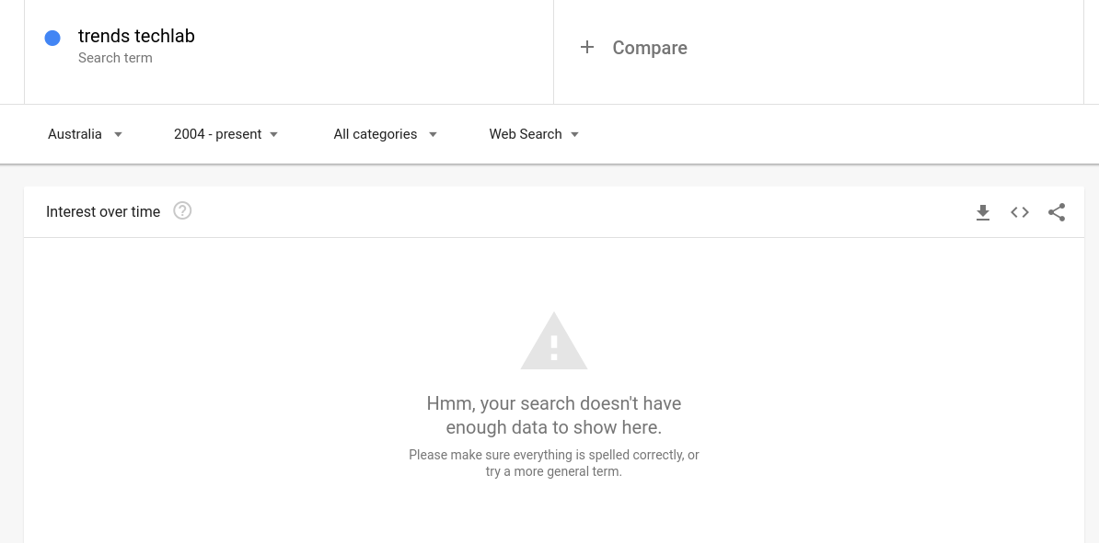

Slide 7
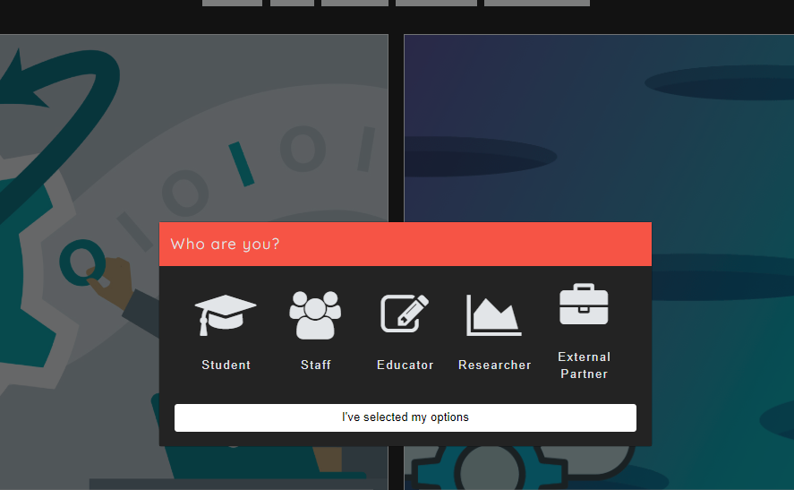
Old Website Walkthrough - Home

Slide 8
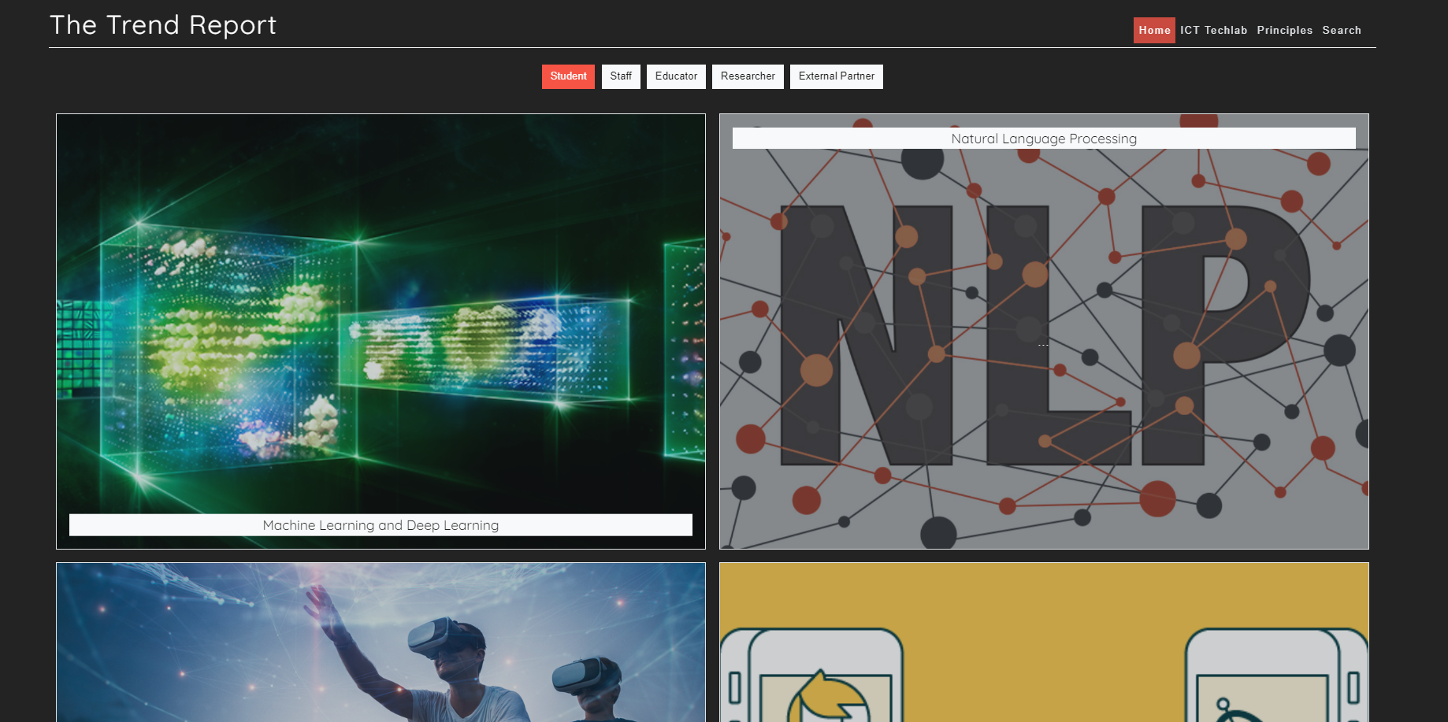
TechLab Trends HomePage

Slide 9
TechLab Previous Issues
Need for a redesigned UI/UX for easier and more engaging browsing.
Basic search capabilities, only shows trends and related projects
No navigation between articles back to home page
Lacks tagging system

Slide 10
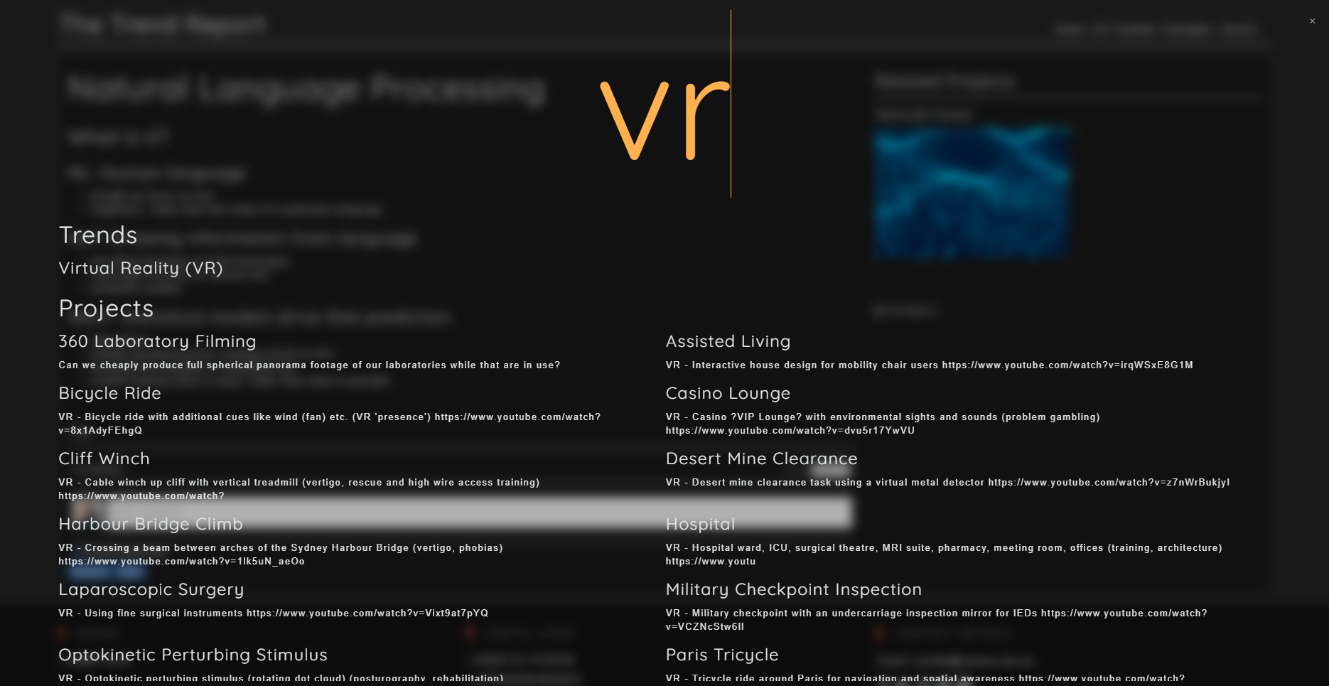
Old Website Walkthrough - Search

Slide 11
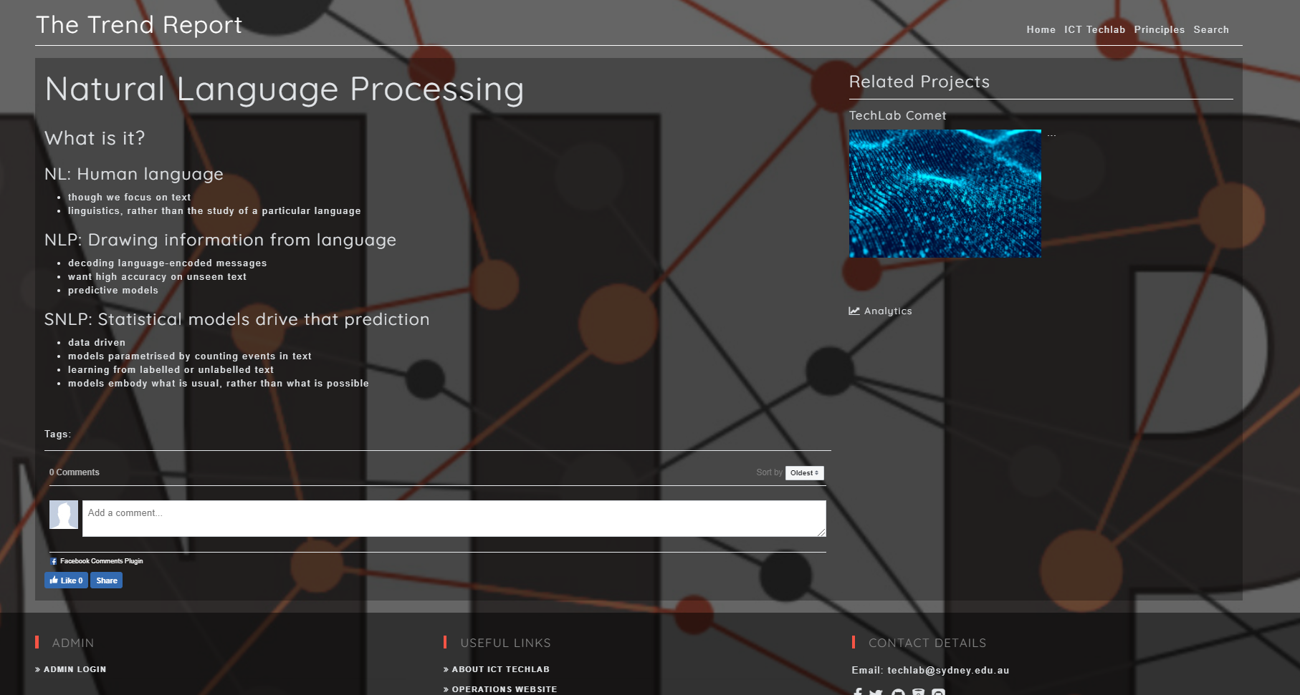
TechLab Trends Article

Slide 12
TechLab Trends - Requirements
Choosing the ‘type of user’ will filter articles on the home page and allow admins to monitor type of engagement
A need for more a sophisticated search for a more tailored user experience.
Improved monitoring of site engagement

Slide 13
User Stories
Notes:
How we prioritised user stories - high priority level for the ones that the client’s requested or showed strong interest. Lower for the ones that we brought it up ourselves to implement. Most of our user stories are bite-sized and estimable as most are modularized into simple functionalities.

Slide 14
User (Reader) stories
As a reader, I would like to filter the website’s content using tags so that I can search for content interesting to me. As a reader, I want an actual usable interface, so that I can properly browse information in The Trend Report. As a reader, I would like to access a page of all works by a specific author so that I can see all articles by that author. As a reader I would like to look through categories and tags so that I can find all related articles at once.
As a reader, I want to know the length of articles so that I can determine whether I have enough time to read through it.
As a reader would like to lazy load articles with infinite scroll so that I can seamlessly browse articles.
As a reader I would like to be able to search for articles so that I can find related articles I am interested in.
As a reader, I would like to expand information specifically related to my role as a student/tutor/academic researcher so that I can see information only relevant to me.
As a reader, I would like to browse through the website without being overwhelmed so that I can browse for longer with comfort
Notes:
HIgh prioritised user stories based on client’s main request such as search function, different level of articles
Each of these high prioritised sprint - get the tests if possible or progress on those.

Slide 15
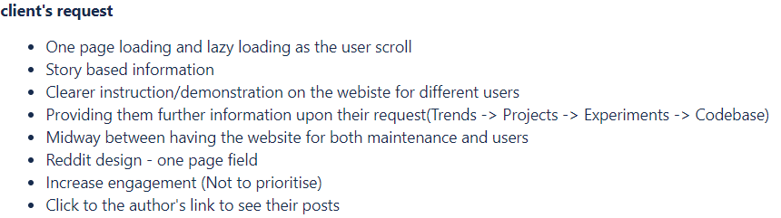
User (Reader) stories with top-priority
As a reader, I would like to expand information specifically related to my role as a student/tutor/academic researcher so that I can see information only relevant to me.
Client requested a functionality to display different level of information upon the reader’s request (Point 4)
Expected sprint 4-5 days without writing the content for each section
Testable and acceptance criteria set by checking with the clients and gain feedback for further request.
Ensure progress with client through weekly meetings
Functional requirement: Readers should be able to select level of information they want to read and expand on more information upon their request
Non-functional requirement: The website should display enhanced accessibility of organised content to the readers of different roles.
Notes:
If no test for specific user story is available or if Cameron or Clinton are going to cover it in their part, go through the user stories in regards to what the client requested.

Slide 16
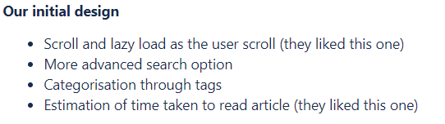
User (Reader) stories with top-priority
As a reader, I would like to look through categories and tags so that I can find all related articles at once.
Our initial design that the clients liked to have implemented as they were also looking for more efficient advanced search and navigation.
Expected sprint 9-10 days to upgrade existing search bar which has no advanced function and tags.
Acceptance criteria set by the clients through meetings.
Ensure progress with client through weekly meetings and look for any need for changes.
Functional requirement: Readers are able to navigate to chosen topics via reader selected categories or tags.
Non-functional requirement: Categories and tags should help the users to browse through the TechLab report with increased efficiency compared to original version.

Slide 17
User (admin) stories
Hi
gh
Low
As an admin, I would like a way to capture user interaction so that I can capture and analyse the type of engagement with the content.
As an admin, I would like to be able to easily add tags to an article so that I can easily categorise the content.
As an admin, I would like to expand on articles about trends by providing sections for Trends -> Projects -> Experiments -> Codebase, so that I can easily add more information about a trend.
As an author, I would like to easily add new admins onto the list so that I can easily give specific permissions.
As an author, I would like to be able to easily change the contents of the reports so that I can easily edit and add changes to the existing posts
As an author, I would like to provide quick navigation to other social networking sites so that the readers can actively communicate with us.
Priority

Slide 18
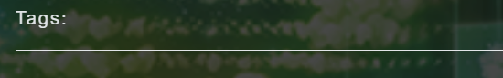
User (Admin) stories with tests
As an admin, I would like to be able to easily add tags to an article so that I can easily categorise the content.
Tag sections on articles are not used by admins at all as it displays nothing. However, client were interested in easy maintenance tags to categorise their articles.
Estimated to take 2-3 days to generate tagging system.
Acceptance criteria would include correct navigation, use and display of tags in the article but also by clients..
Ensure progress with client through weekly meetings and look for any need for changes..
Functional requirement: Admins should be able to easily add or edit tags through edit tag or add tag function.
Non-functional requirement: If implemented, it should increase the quality of maintainability of the articles and reports for the admins as it supports organisation of articles based on categories for the admins.

Slide 19
Stretch Goals
As a user, I would like to be notified of upcoming events and view all upcoming events
As an author, I would like to be able to notify users of upcoming events related to TechLab
As a user, I want to be able to have a storage of my last viewed, favourited and ‘read later’ articles in order to improve viewing experience
As a user I want to have an integrated chatbox so that I can be able to communicate with support quickly and determine a field I am interested in..
As a user I would like to have a modal design when browsing through articles, this way it allows me to easily navigate around the website.

Slide 20
Front End

Slide 21
Front-end - Tools & Frameworks
React:
Javascript framework/library
Chosen for its compositional nature (high reusability)
High capability (safety net if client expands requirements)
Fast development compared to vanilla JS
HTML/CSS:
As standard
Sass:
CSS preprocessor
Improves maintainability and structure of CSS (7-1 architecture)

Slide 22
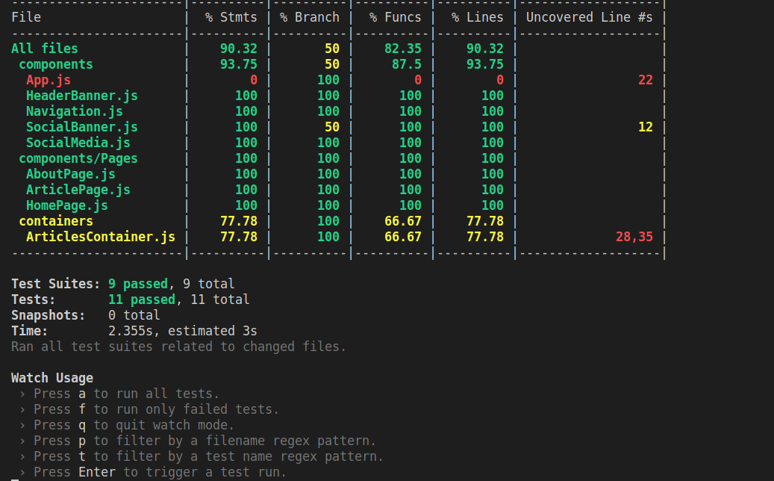
Jest:
Javascript unit and integration testing
Chosen because it includes testing, coverage reporting and mocking
Familiar with it so no learning time required
Enzyme:
Testing library build by airbnb for testing React components
Used to mount components on a virtual DOM for interaction/assertion
Cypress.io:
E2E testing library
Can traverse a website simulating events
Will be used for total system tests ensuring front
and back end communicating correctly

Slide 23
Front-end - Test Examples
Story #1: As a reader I want to search for articles so I can find related articles that I'm interested in
Test plan:
System test: Cypress will be used. It will trigger a search and assert at least one article has been returned and rendered by the search by looking for the component's data-componentType attribute
An enzyme test will be written with a mounted <SearchResultsContainer /> component which will make an API call to a mocked endpoint. We will assert the <SearchResultsContainer /> renders the correct SearchResult components (based on the mock)
Story #2 : As a reader I would like to look through categories and tags so I can find all related articles at once
System test: Cypress - trigger a search with a specific tag set, assertion iterates over each search result ensuring all have the matching tag rendered in the DOM

Slide 24
Back End

Slide 25
Back-end - Tools & Frameworks
Python3.5/Django
MVC web framework
Thoroughly featured for complex web development
Built-in database features
Built-in user system
Administration tools
Industry standard security implementations
Used in large-scale industry applications
Social media: Instagram, Spotify, Youtube
Cloud services: Dropbox, Bitbucket
Framework used in existing implementation
Does not require system changes to server

Slide 26
Back-end - Tools & Frameworks
MySQL Databases
Reliable, secure DBMS, used commonly in industry applications
Military/Government applications: US navy, NASA
Social media/News: Tumblr, Twitter, BBC News
Django support for MySQL 5.6+
DBMS used in existing implementation

Slide 27
Quality Assurance

Slide 28



System Architecture

Slide 29
Django - RESTful API framework
Web framework for Python 3.5
Used for the original Techlab Trends codebase
Front-end: Integrates ReactJS to serve practical interfaces
Back-end: Integrates MySQL using Connectors to fulfill database-related requirements.

Slide 30
Front-end Testing

Slide 31
Back-end Testing
Purpose of system back-end is to resolve API calls
Unit testing: Standard Python unittest module for Django
API reference to be used as foundation of testing I/O, e.g. For valid input “GET /article/[id]”, Expect JSON object: { success: true, article: { title: [article id title], content: title: [article id content], image: title: [article id header image], author: [article id author], tags: [tags associated with article id] } };
Security testing
Common SQL injection vectors
Cross-site vulnerabilities (XSS/CSRF)
Stress testing for availability under high load

Slide 32
Coverage Reports or paste screenshot of test

Slide 33
Group Collaboration and processes

Slide 34

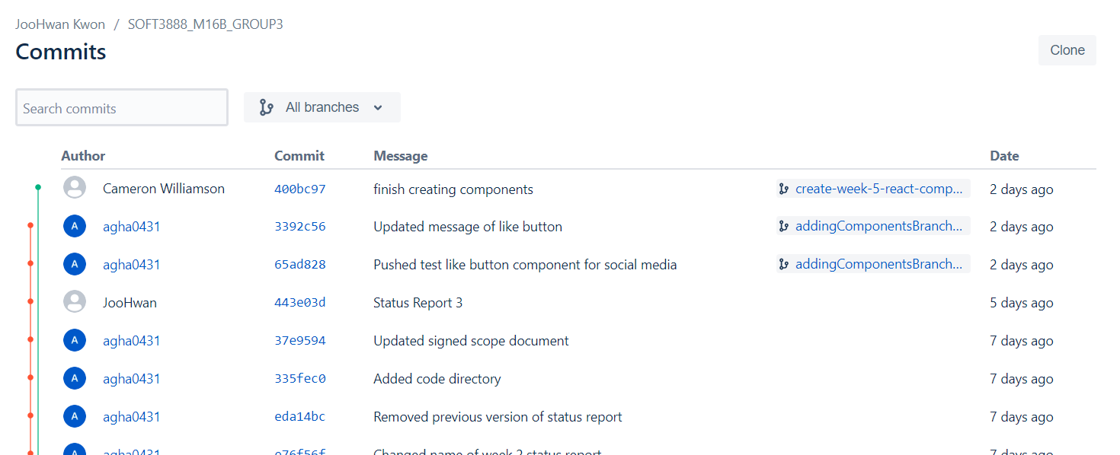
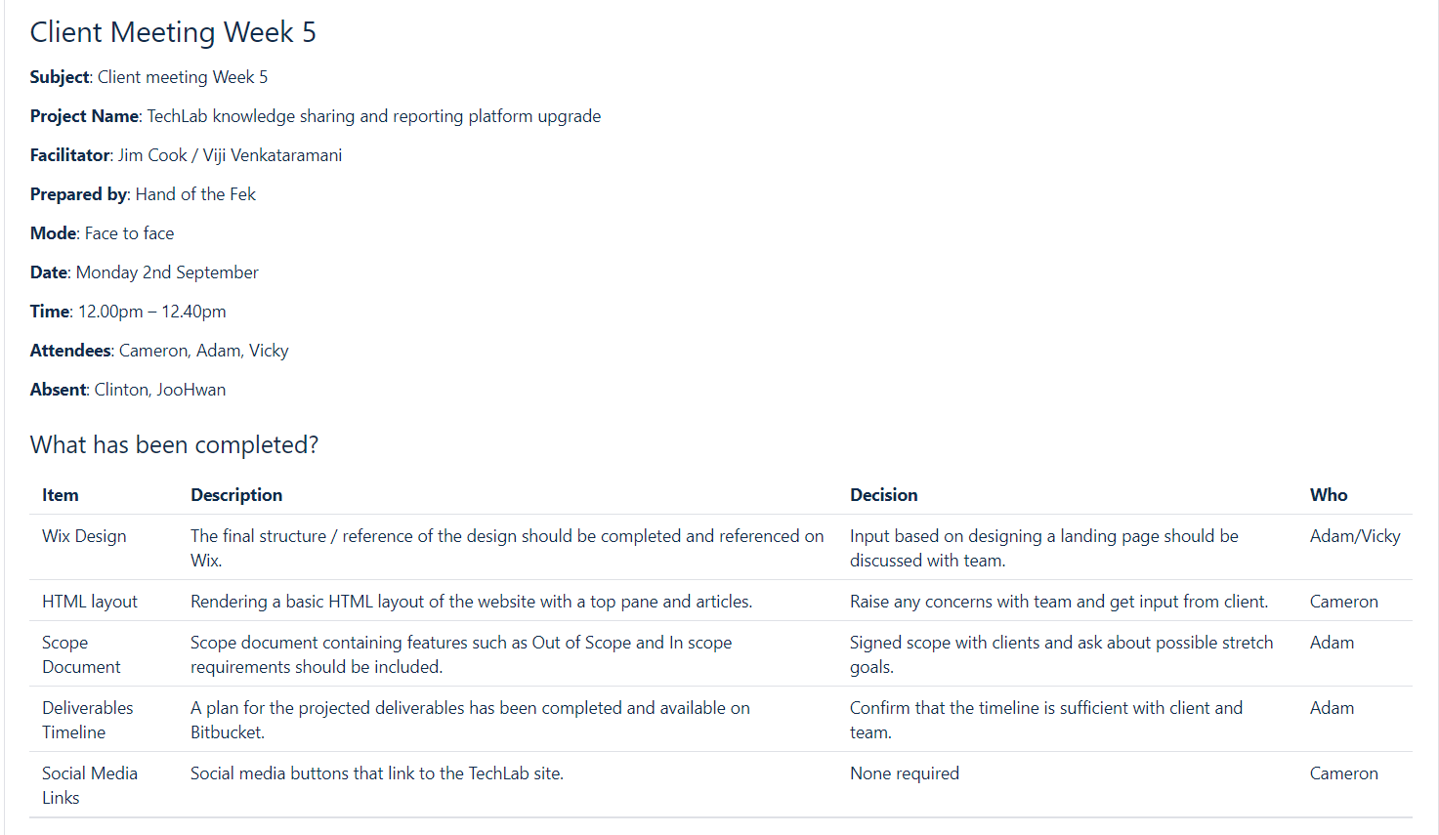
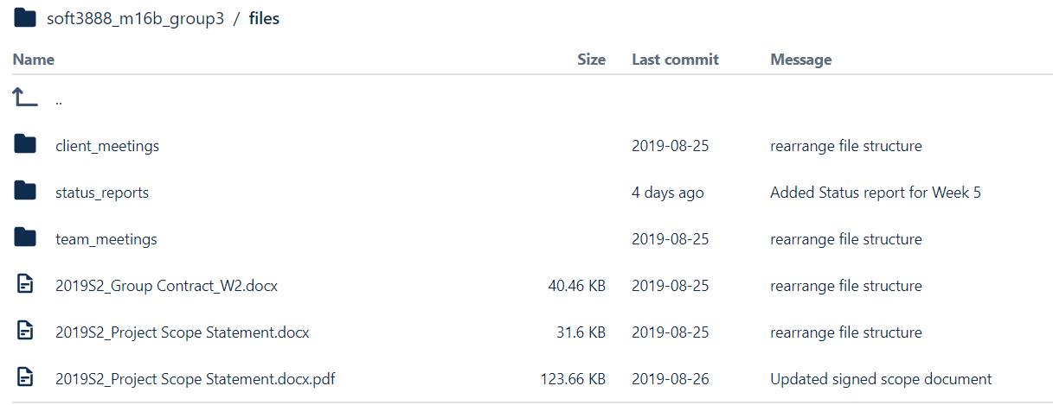
Bitbucket - Git repository for codebase & files

Slide 35
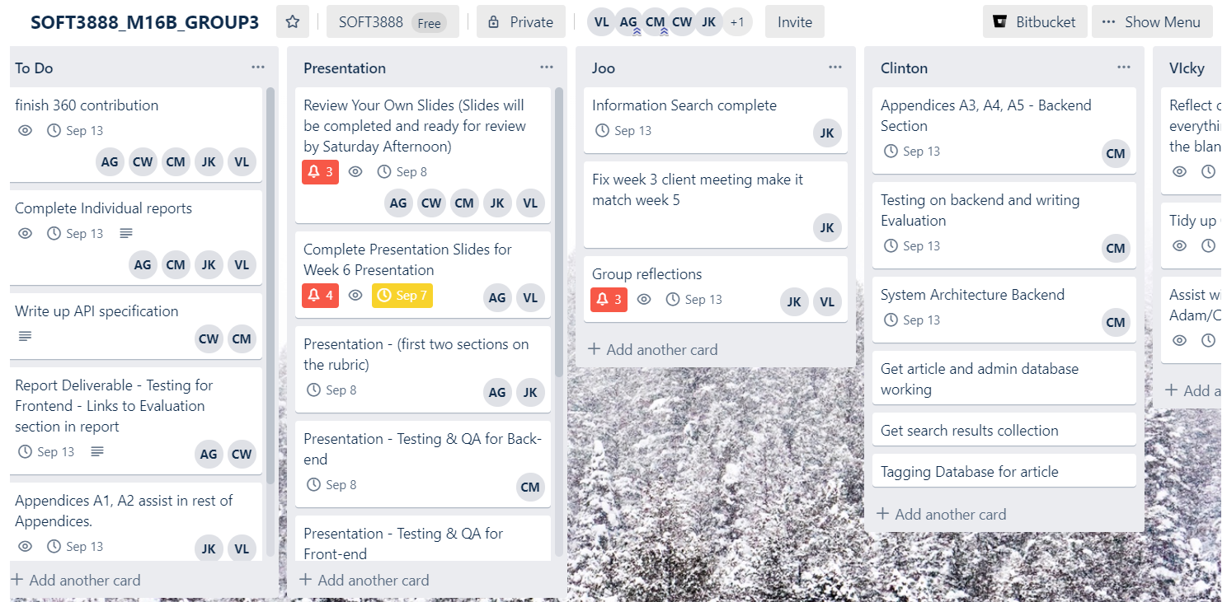

Trello Board
Trello Board
Notes:
Trello T

Slide 36
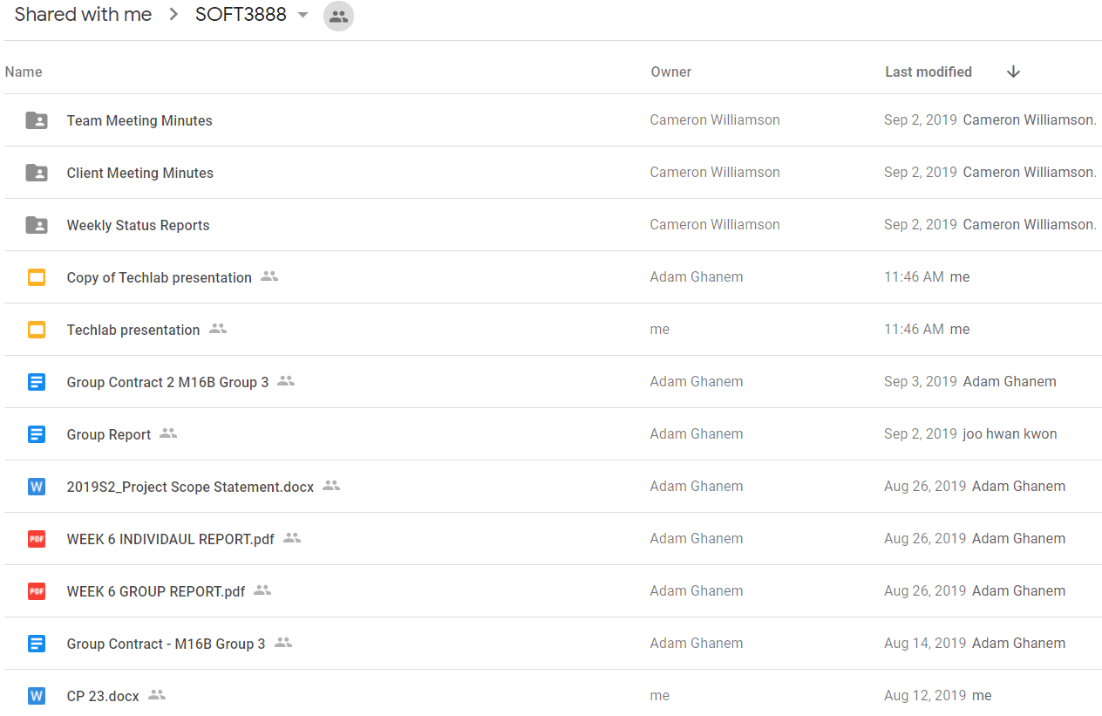

Collaboration over documents

Slide 37
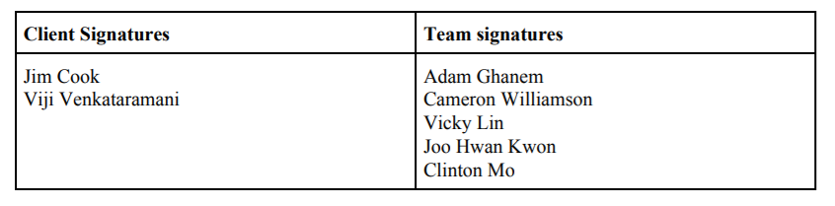
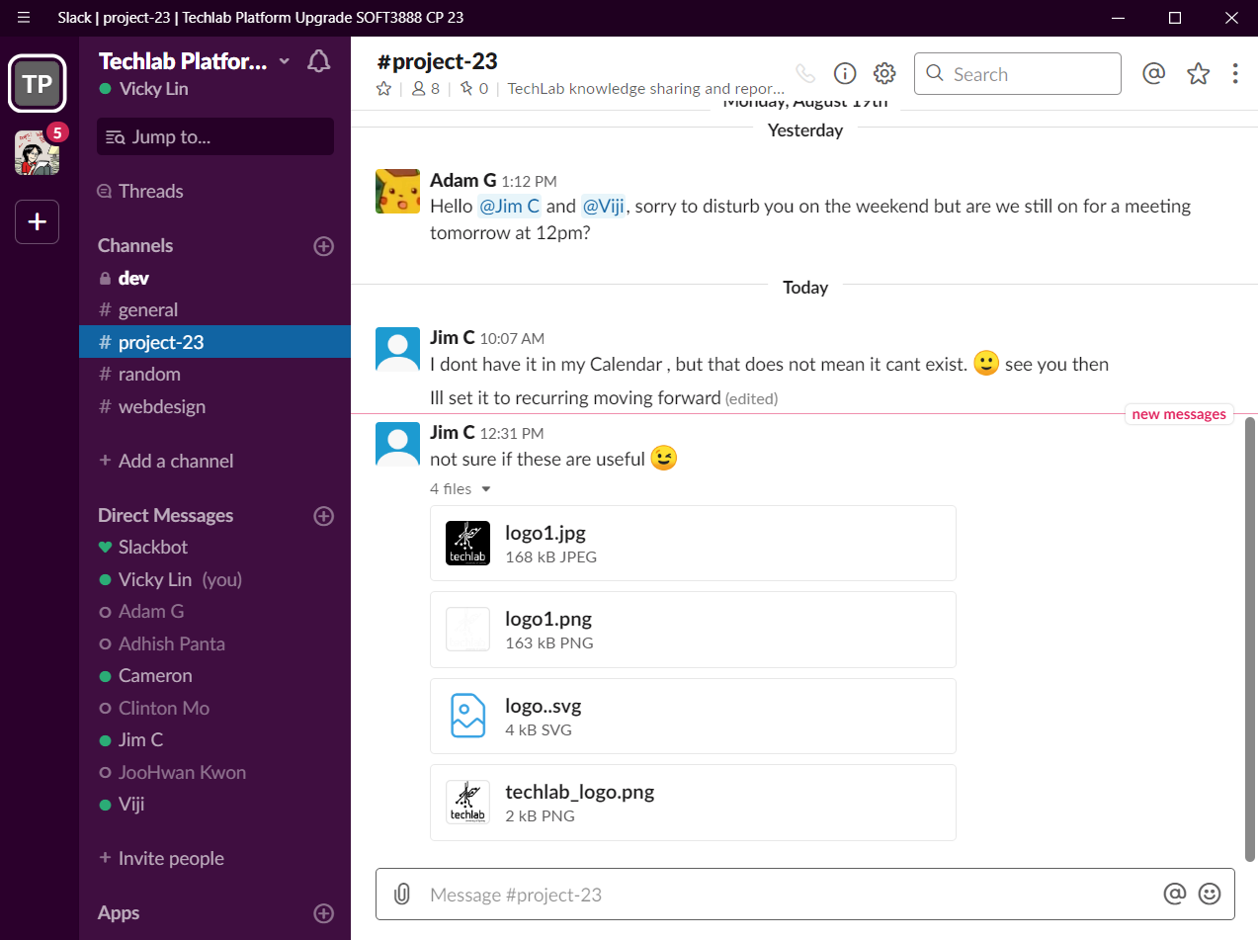
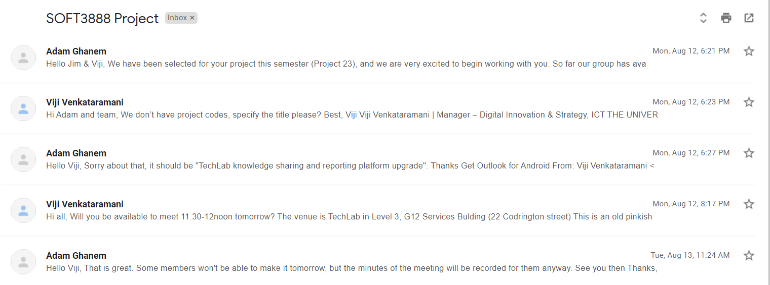

Slack - Client
interaction
Scope Statement signatures
Email correspondence with clients

Slide 38
XP
Directly Responsible Individuals (DRI)
Promotes taking ownership for tasks and therefore holding members accountable
Alleviates strain on manager
XP Role | Members
Tracker | Adam
Manager | Adam
Customer | JooHwan
Programmer | Clinton
Tester | Vicky
Doomsayer | Cameron
Group Roles
Git Expert - Cameron Slack Expert - Clinton BitBucket Expert - Adam XP Expert - JooHwan, Vicky

Slide 39
Critique
What has worked well
Members are present at offline meetings and responsive offline - great communication
Trello board is great at keeping track of tickets and goals
Experts made sure the team is aware of all the components used in the project
XP roles assigned each member responsibilities as a group member. E.g. the manager helps run smooth meetings and delegates tasks quickly
What needs improvement
Changed Trello board so each member has a section for their tasks to have clearer division of tasks
Decomposition of tasks so that each member was directly responsible for more specific work packages.

Slide 40

Thank you

